Slide 1
Algorithms: K Nearest Neighbors

Slide 2


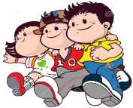
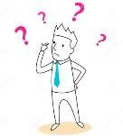

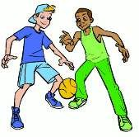
Simple Analogy..
Tell me about your friends(who your neighbors are) and I will tell you who you are.

Slide 3

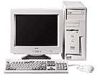



Instance-based Learning
Its very similar to a Desktop!!

Slide 4
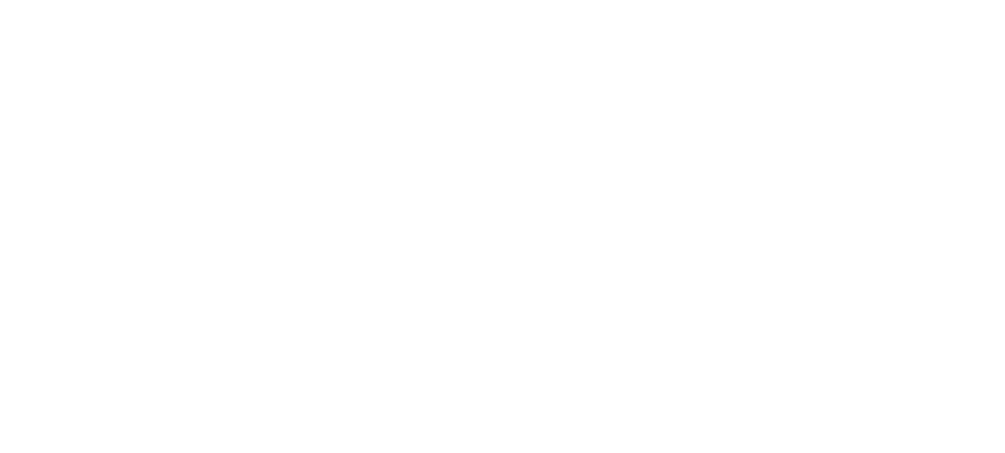
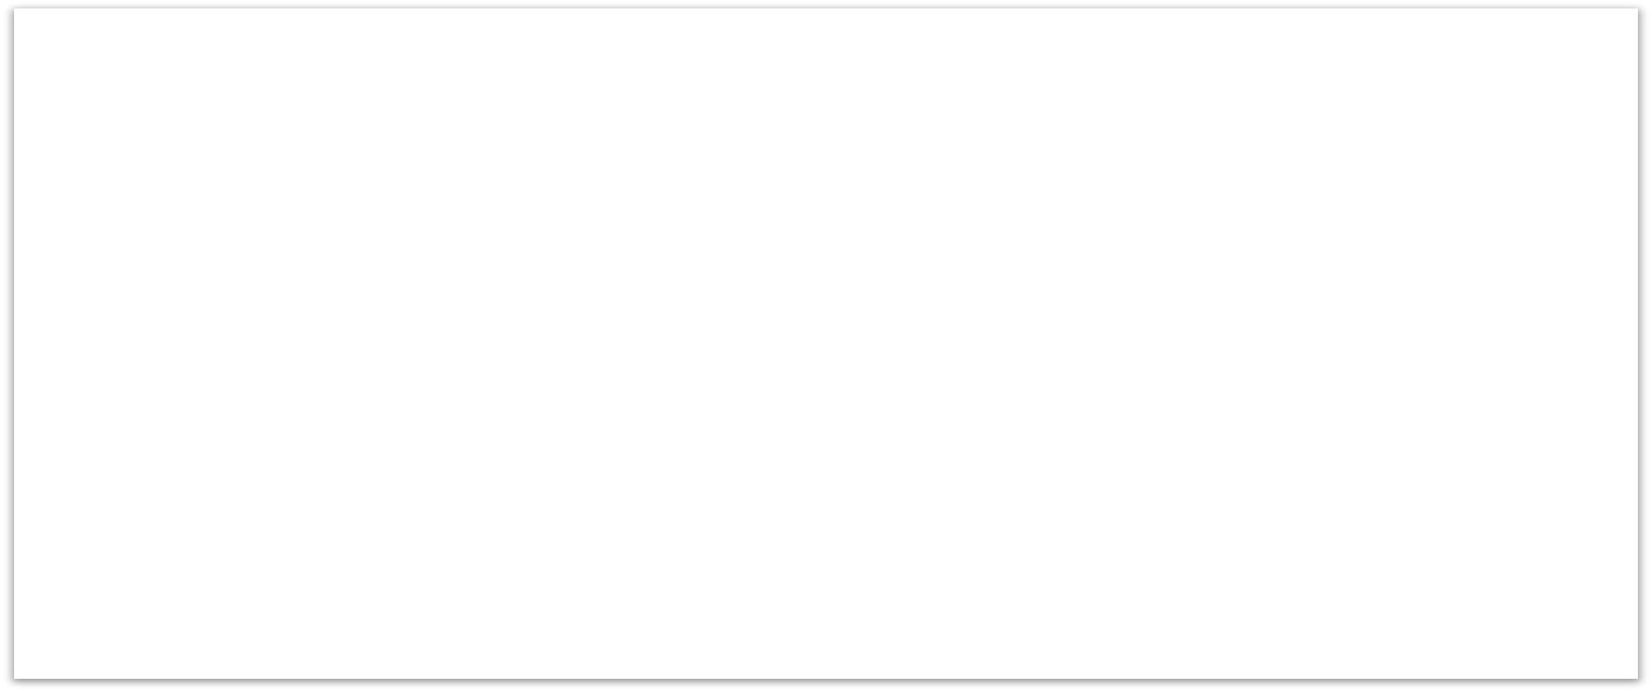

KNN – Different names
K-Nearest Neighbors
Memory-Based Reasoning
Example-Based Reasoning
Instance-Based Learning
Lazy Learning

Slide 5
What is KNN?
A powerful classification algorithm used in pattern recognition.
K nearest neighbors stores all available cases and classifies new cases based on a similarity measure(e.g distance function)
One of the top data mining algorithms used today.
A non-parametric lazy learning algorithm (An Instance- based Learning method).

Slide 6
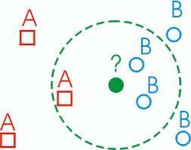
KNN: Classification Approach
An object (a new instance) is classified by a majority votes for its neighbor classes.
The object is assigned to the most common class amongst its K nearest neighbors.(measured by a distant function )

Slide 7
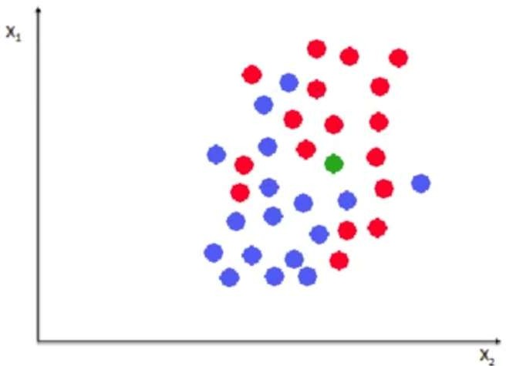

Slide 8
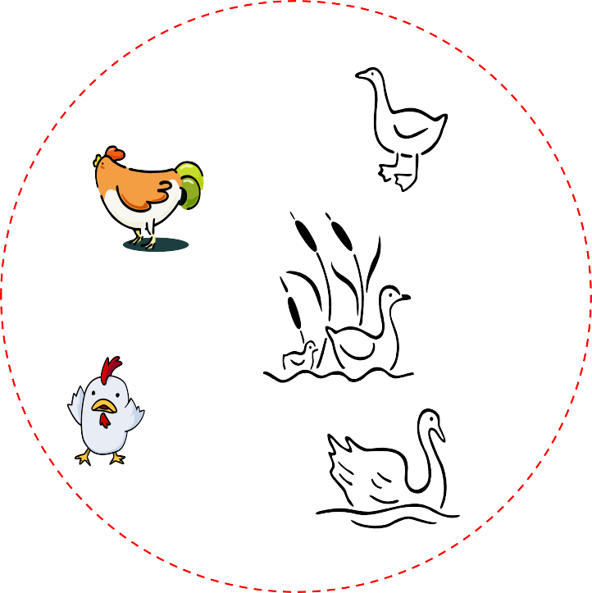

Distance Measure
Compute
Distance
Test Record
Training
Records
Choose k of the
“nearest” records

Slide 9
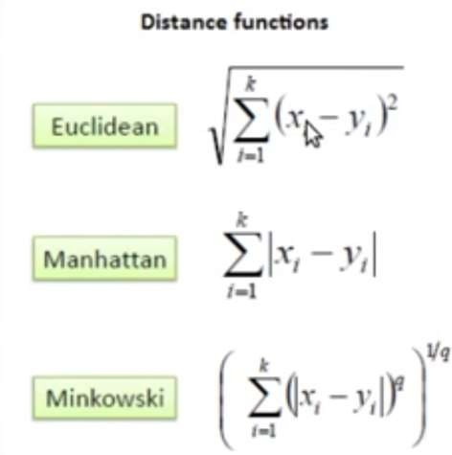
Distance measure for Continuous Variables

Slide 10
Distance Between Neighbors
Calculate the distance between new example
(E) and all examples in the training set.
Euclidean distance between two examples.
– X = [x1,x2,x3,..,xn]
– Y = [y1,y2,y3,...,yn]
– The Euclidean distance between X and Y is defined
as:
n
D( X ,Y ) =
∑
i=1
(x_{i} − y_{i} )
2
11

Slide 11
K-Nearest Neighbor Algorithm
All the instances correspond to points in an n-dimensional feature space.
Each instance is represented with a set of numerical attributes.
Each of the training data consists of a set of vectors and a class label associated with each vector.
Classification is done by comparing feature vectors of different K nearest points.
Select the K-nearest examples to E in the training set.
Assign E to the most common class among its K-nearest neighbors.

Slide 12
How to choose K?
If K is too small it is sensitive to noise points.
Larger K works well. But too large K may include majority points from other classes.
X
Rule of thumb is K < sqrt(n), n is number of examples.

Slide 13
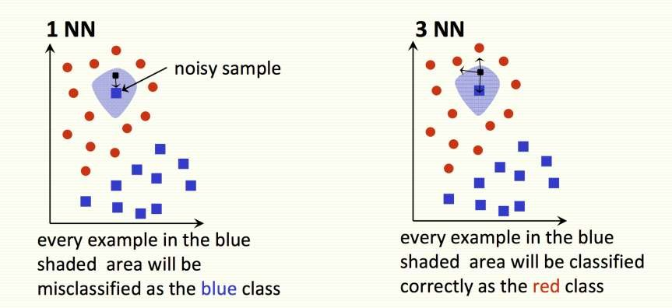

Slide 14

X
X
X
(a) 1-nearest neighbor (b) 2-nearest neighbor (c) 3-nearest neighbor
K-nearest neighbors of a record x are data points that have the k smallest distance to x

Slide 15
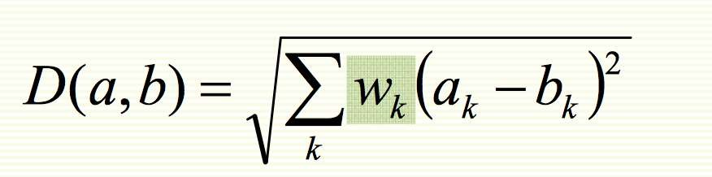
KNN Feature Weighting
Scale each feature by its importance for classification
Can use our prior knowledge about which features are more important
Can learn the weights w_{k} using cross‐validation (to be covered later)

Slide 16

Feature Normalization
Distance between neighbors could be dominated by some attributes with relatively large numbers.
e.g., income of customers in our previous example.
Arises when two features are in different scales.
Important to normalize those features.
– Mapping values to numbers between 0 – 1.

Slide 17
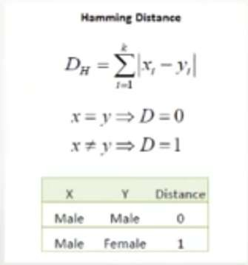
Nominal/Categorical Data
Distance works naturally with numerical attributes.
Binary value categorical data attributes can be regarded as 1 or 0.

Slide 18
KNN Classification
$250,000
$200,000
$150,000
Loan$
Non-Default Default
$100,000
$50,000
$0
0
10
20
30
40
50
60
70
Age

Slide 19


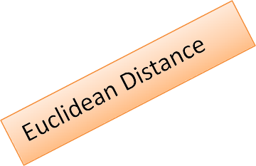

KNN Classification – Distance
Age | Loan | Default | Distance
25 | $40,000 | N | 102000
35 | $60,000 | N | 82000
45 | $80,000 | N | 62000
20 | $20,000 | N | 122000
35 | $120,000 | N | 22000
52 | $18,000 | N | 124000
23 | $95,000 | Y | 47000
40 | $62,000 | Y | 80000
60 | $100,000 | Y | 42000
48 | $220,000 | Y | 78000
33 | $150,000 | Y | 8000
48 | $142,000 | ?
D = (x − x )² + ( y − y )²
1 2 1 2

Slide 20




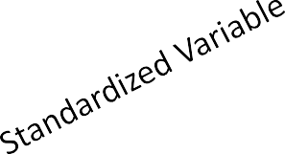
KNN Classification – Standardized Distance
Age | Loan | Default | Distance
0.125 |  | 0.11 N | 0.7652
0.375 |  | 0.21 N | 0.5200
0.625 |  | 0.31 | 0.3160
0 |  | 0.01 | 0.9245
0.375 |  | 0.50 | 0.3428
0.8 |  | 0.00 | 0.6220
0.075 |  | 0.38 | 0.6669
0.5 |  | 0.22 | 0.4437
1 |  | 0.41 | 0.3650
0.7 |  | 1.00 | 0.3861
0.325 |  | 0.65 | 0.3771
0.7 |  | 0.61
N N N N Y Y Y Y Y
?
X − Min
X =
s
Max − Min

Slide 21
Strengths of KNN
Very simple and intuitive.
Can be applied to the data from any distribution.
Good classification if the number of samples is large enough.
Weaknesses of KNN
Takes more time to classify a new example.
need to calculate and compare distance from new example to all other examples.
Choosing k may be tricky.
Need large number of samples for accuracy.

Slide 22
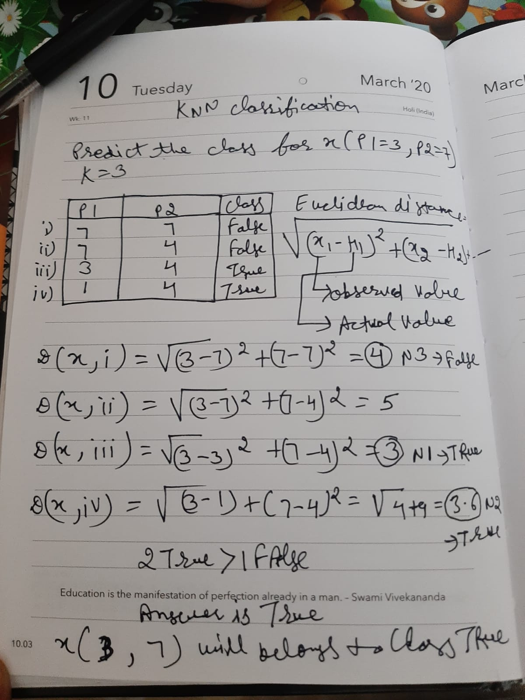

Slide 23
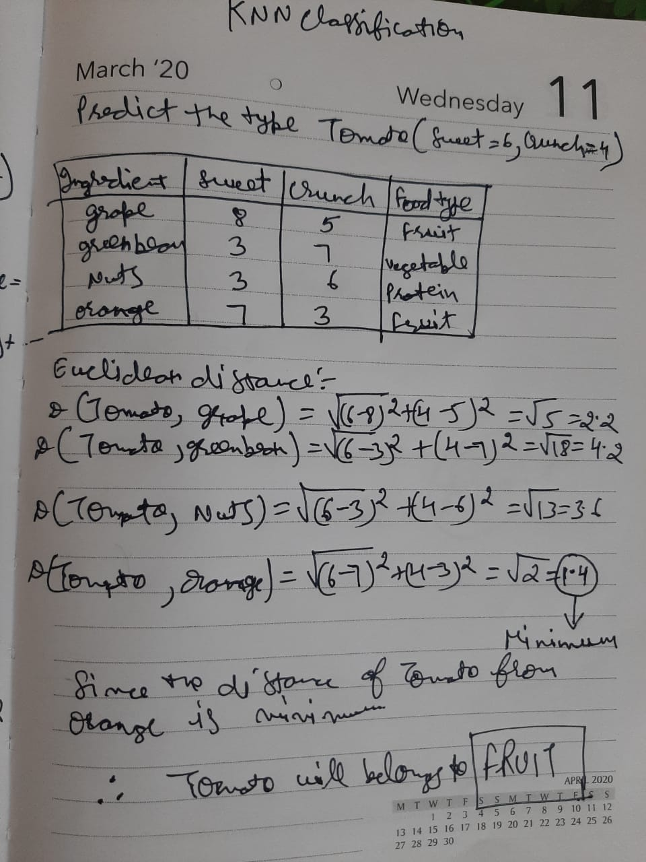

Slide 24
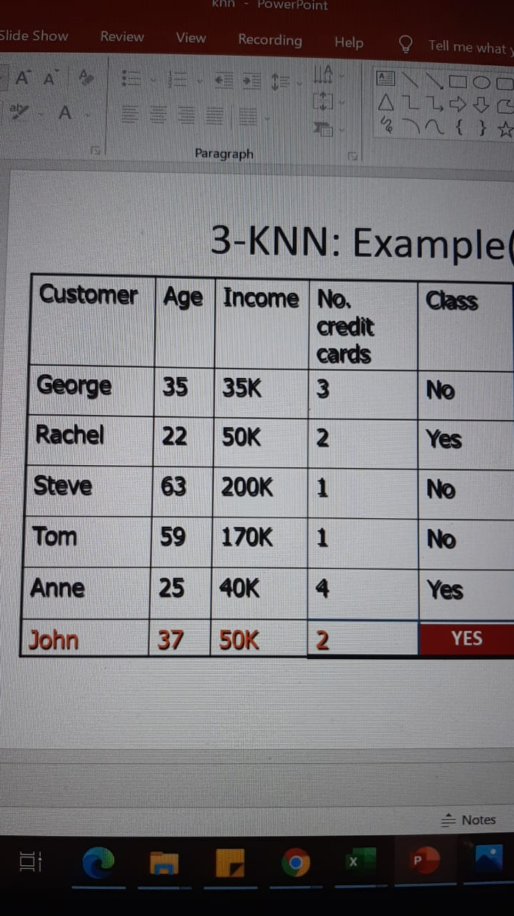

Slide 25



3-KNN: solution
Distance from John
sqrt [(35-37)²+(35-50)² +(3- 2)²]=15.16
sqrt [(22-37)²+(50-50)² +(2- 2)²]=15
sqrt [(63-37)²+(200-50)² +(1- 2)²]=152.23
sqrt [(59-37)²+(170-50)² +(1- 2)²]=122
sqrt [(25-37)²+(40-50)² +(4- 2)²]=15.74

